Slide 1
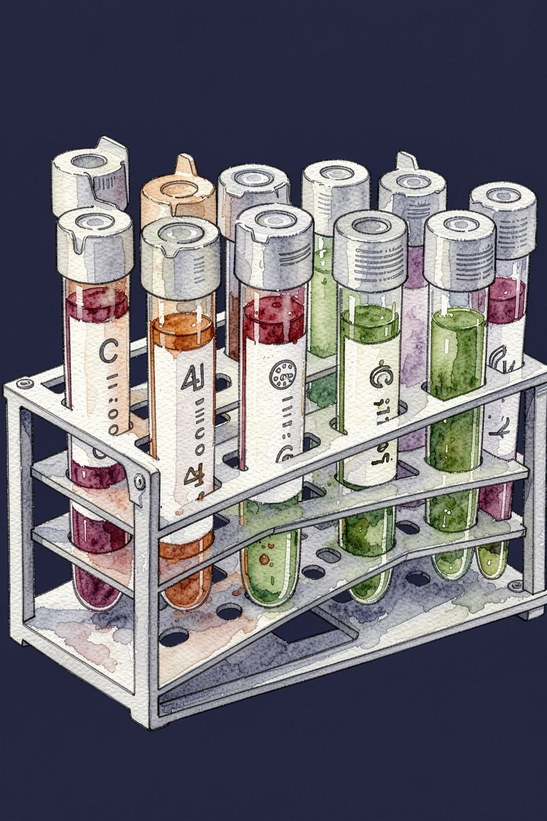
VitalScan AI — Disease Prediction System
Real-Time Blood Biomarker Screening Using Supervised Machine Learning

Slide 2



Problem Statement & Clinical Objective
The Need for Automated Preliminary Screening
The Challenge
Class 0 — Healthy
Routine lab panels contain 20+ interrelated biomarkers; manual assessment can delay critical diagnostic triage.
All clinical markers within acceptable tolerances.
Class 1 — Disease Present
The Solution
Actionable markers indicate clinical risk requiring physician review.
A rapid, data-driven binary classification system to flag disease presence from routine blood tests.
Clinical Value: Speeds up preliminary pathology triage and reduces human oversight.

Slide 3




Dataset Architecture & 24 Biomarkers
Clinical Indicators Structured Across 4 Panels
Dataset Profile: 2,837 total records sanitized to 551 unique patient samples; 24 continuous blood test features. All biomarkers standardized via StandardScaler to mean=0, variance=1.
Metabolic Panel
Complete Blood Count (CBC)
Glucose
Insulin
HbA1c
Body Mass Index (BMI)
Hemoglobin, Platelets, WBC, RBC
Hematocrit, MCV, MCH, MCHC
Cardiovascular & Vitals
Lipid, Hepatic & Renal
Systolic BP, Diastolic BP
Heart Rate, Cardiac Troponin, CRP
Cholesterol, Triglycerides, LDL, HDL
ALT, AST, Serum Creatinine

Slide 4

End-to-End Machine Learning Pipeline
Systematic 5-Stage Engineering Workflow
Target Encode
Normalize
Clean & Dedup
Split 80/20

Slide 5
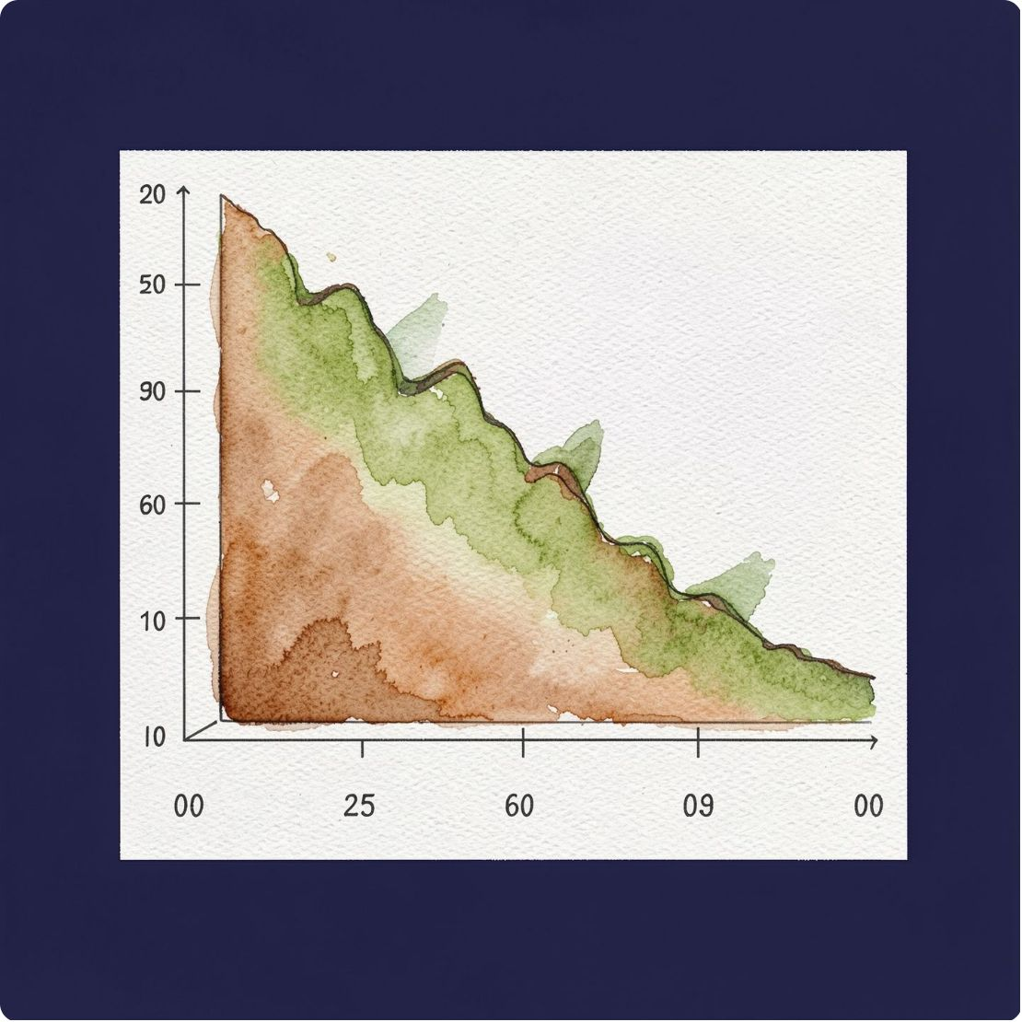

Core Model — Logistic Regression
Mathematical Formulation & Decision Boundary
Linear Predictor Function
z = w0 + w1·x1 + w2·x2 + ... + w24·x24
Sigmoid Probability Mapping
P(Disease = 1) = 1 / (1 + e^-z)
Decision Rule (0.50 Threshold)
If P(Disease) ≥ 0.50 → Class 1 (Disease Detected)
If P(Disease) < 0.50 → Class 0 (Healthy Status)
Why Logistic Regression? Provides complete clinical interpretability through learned weights, fast inference, and zero overfitting risk.

Slide 6
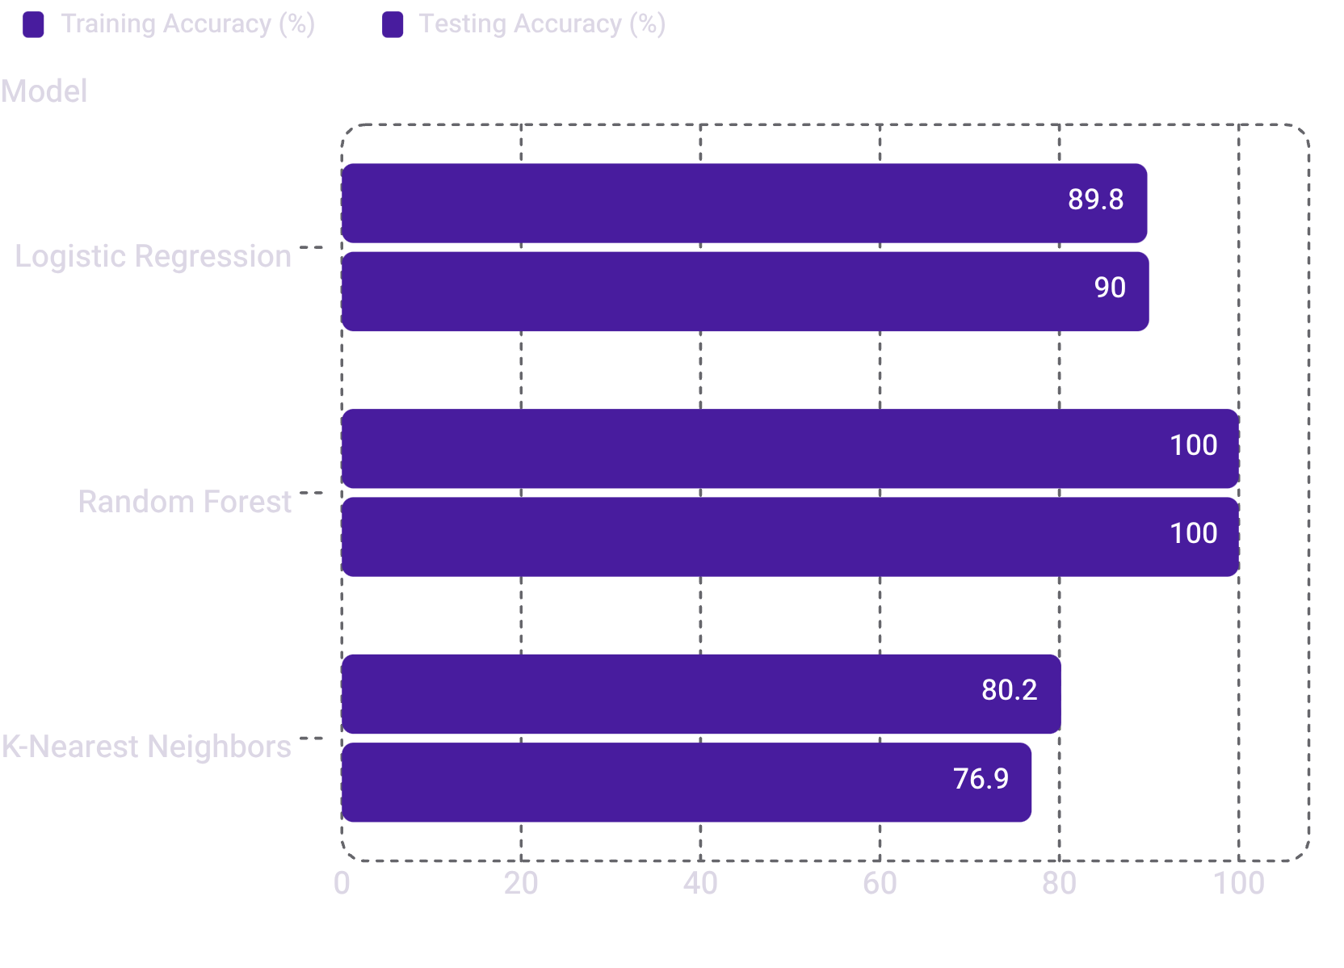


Model Comparison & Benchmarking
Evaluation Across Supervised Classifiers
Conclusion: Logistic Regression delivers strong test performance with transparent diagnostic weight explainability.
✅ Logistic Regression (Selected)
Random Forest Classifier
K-Nearest Neighbors (KNN)
~89.8% train / ~88.5%–91.5% test. High interpretability, stable generalization, fast inference.
100% train & test accuracy. Ensemble black-box; high complexity — not selected for clinical use.
~80.2% train / ~76.9% test. Distance metric degrades in high-dimensional feature space.

Slide 7
Evaluation Metrics & Diagnostic Quality
Rigorous Validation on Unseen Test Data
~90%
0.96
Overall Accuracy
Precision
~89%–91.5% correct classifications on unseen patient test samples.
96% of cases flagged as "Disease" are true clinical positives — extremely low false alarm rate.
0.85
0.90
Recall
F1-Score
Effectively identifies 85% of all positive pathology cases, preventing missed medical diagnoses.
Harmonic balance between diagnostic sensitivity and precision. Confusion matrix confirms reliable class boundary separation.

Slide 8
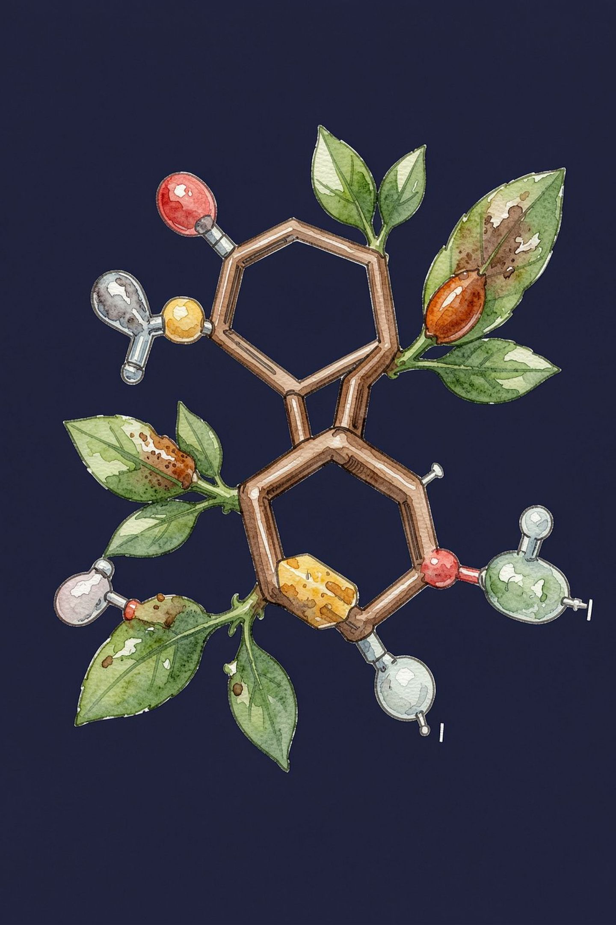


Key Risk Drivers & Learned Biomarkers
Aligning Machine Learning Coefficients with Clinical Science
Primary Disease Drivers — Positive Coefficients
Protective Factors — Negative Coefficients
Glucose & HbA1c
HDL "Good" Cholesterol
Dominant indicators for diabetic risk and metabolic syndrome.
Correlates strongly with healthy status.
Cardiac Troponin & CRP
Normal Hemoglobin
Critical signals for myocardial distress and systemic inflammation.
Correlates strongly with healthy status.
Cholesterol & Triglycerides
Clinical Alignment: Learned mathematical weights directly reflect real medical diagnostic criteria.
Primary drivers for cardiovascular pathology.

Slide 9




VitalScan AI Web Application
Interactive Clinical Dashboard Built with Flask & Tailwind CSS
Compact 2×2 Input Grid
Patient Presets Dropdown
Real-Time Inference Engine
Abnormal Factor Breakdown
24 biomarkers logically grouped into 4 clinical panels above the fold for rapid data entry.
Instant test profiles: Healthy Adult, Diabetes Risk, Anemia, Cardiac Alert, Thrombocytopenia.
Instant computation using serialized model.joblib and scaler.joblib.
Filters out optimal values and highlights only non-normal markers with "Should Be" target ranges.

Slide 10

Production Deployment & Conclusion
Cloud Architecture on Render & Project Summary
Cloud Deployment
🔬 Multi-Class Diagnosis
Deployed on Render.com powered by Gunicorn WSGI.
Production configuration: render.yaml, Procfile, requirements.txt.
Dedicated /healthz monitoring endpoint for continuous uptime verification.
Expanding beyond binary classification to identify specific condition categories.
🏥 EHR Integration
Connecting VitalScan AI directly with Electronic Health Record systems for seamless clinical workflow.
Key Takeaways
Successfully implemented an end-to-end ML classification pipeline (~90% test accuracy).
Deployed an accessible diagnostic tool combining ML rigor with practical healthcare utility.
FUTURE SCOPE

